Slide 1
Reinforcement Learning based stabilization of liquid surface in ground vehicle payloads
EEN-400A BTP
Instructor: Prof. Sohom Chakrabarty
Group Member
Keshav Dixit (Enr. no. 18115050)
Kshitij Bithel (Enr. no. 18115053)

Slide 2
MOTIVATION
Sloshing, a complex nonlinear dynamical phenomenon which has a significant influence on the stability of the fluid system.
It affects various engineering systems and processes.
Previous model-based approaches suffer from Inaccuracies. So, we choose to use Reinforcement Learning methods
Notes:
- Sloshing refers to the motion of a free liquid surface inside its container and is a complex nonlinear dynamical phenomenon which has a significant influence on the stability of the fluid system.
- It affects various engineering systems and processes.such as liquid storage tanks, liquid rocket fuel tanks, molten metal handling in steel plants, robotic handling of liquids, etc.
- Previous model-based approaches suffer from Inaccuracies. So, we choose to use Reinforcement Learning methods which learn models and control actions directly from data and experiments

Slide 3
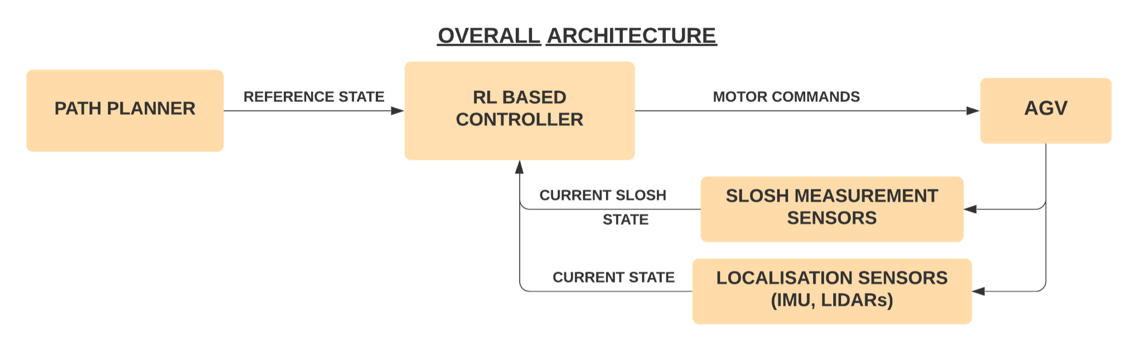
OBJECTIVE
To use Reinforcement Learning (RL) based control to navigate an Automated Guided Vehicle (AGV) while minimizing slosh in a liquid payload as well as following a desired path to reach the destination in minimum possible time.
Notes:
To use Reinforcement Learning (RL) based control to navigate an Automated Guided Vehicle (AGV) prototype in a 2-D workspace, while minimizing slosh in a liquid payload as well as following a desired path to reach the destination in minimum possible time.

Slide 4
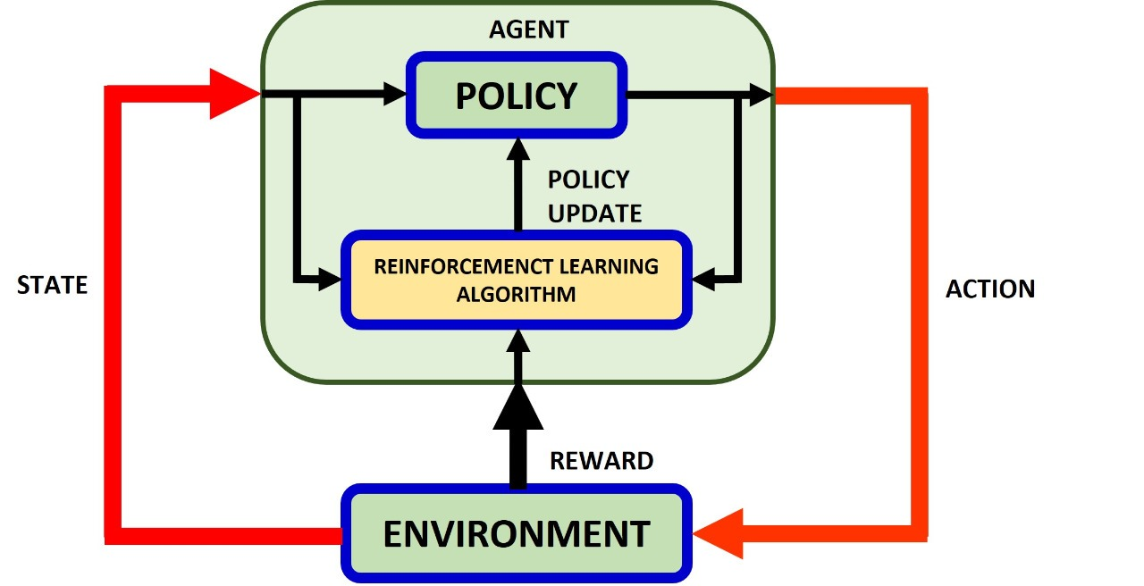
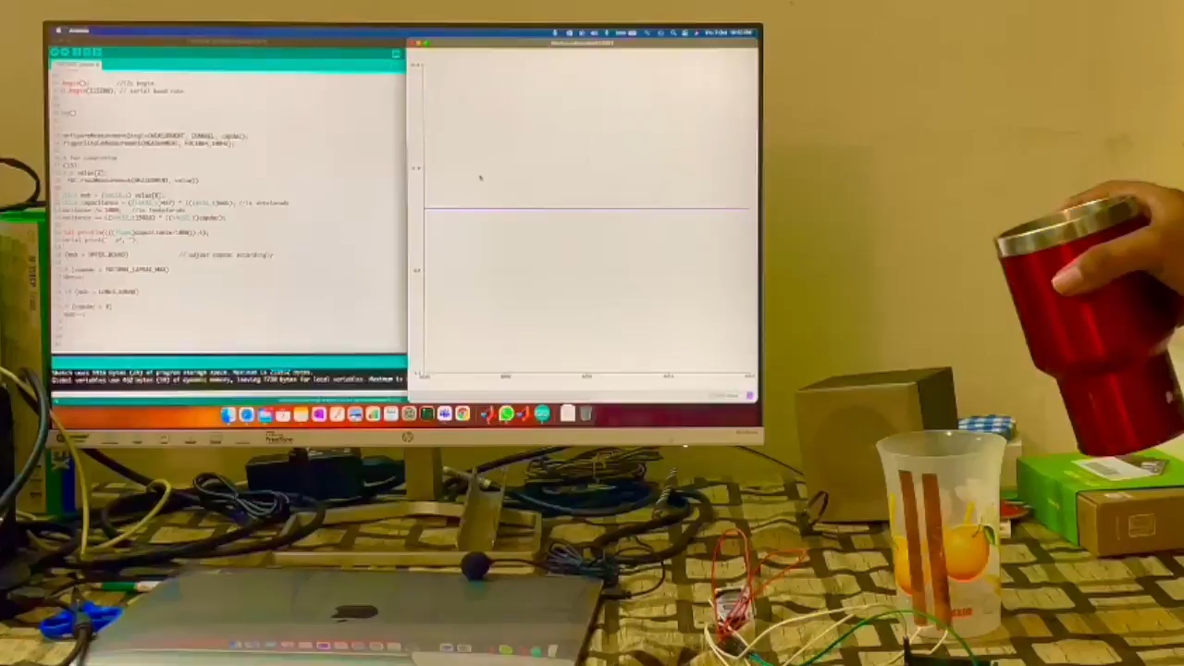
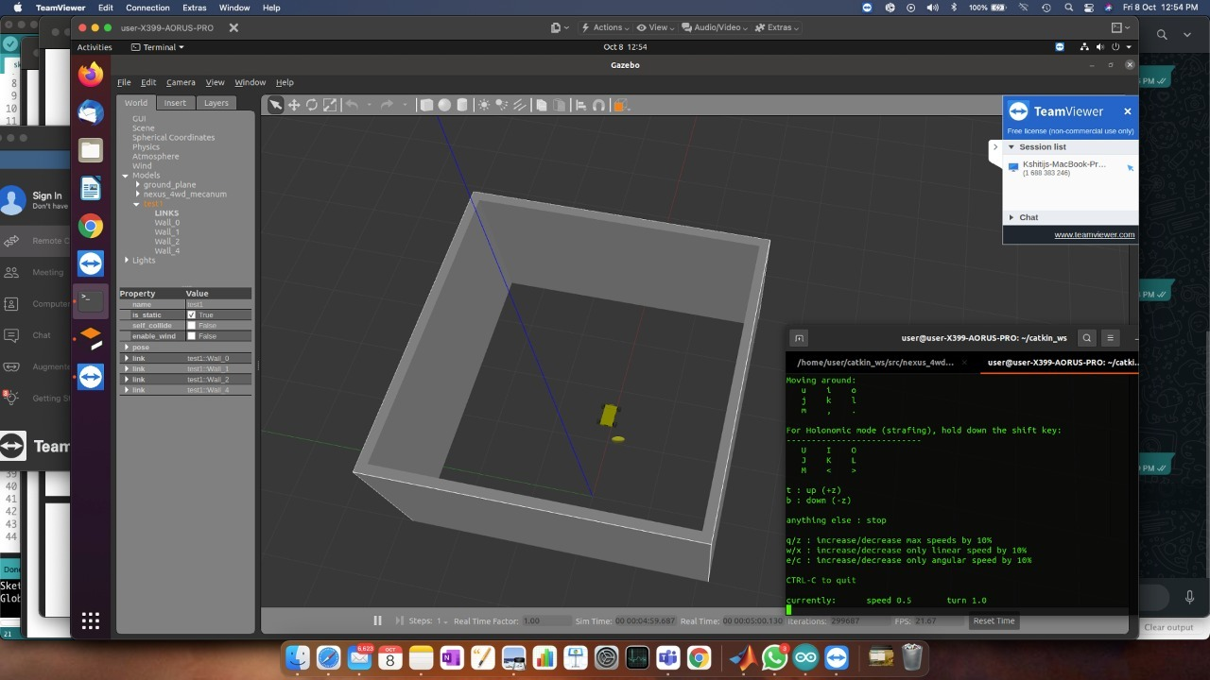
METHODOLOGY
REINFORCEMENT LEARNING FRAMEWORK
SLOSH MEASUREMENT TECHNIQUE
Gazebo Simulation of Robot Navigation

Slide 5
EXPECTED OUTCOME
Working Hardware Prototype of AGV
Reliable Slosh Measurement Sensing Technique
An RL based control model for the AGV capable of minimising slosh in payload liquids while following desired 2-D paths
Source : Omron Water Sloshing Suppression Control

Slide 6
REFERENCES
[1] H. N. Abramson, “The dynamic behavior of liquids in moving containers,Technical Report, NASA, Washington, DC, USA,” 1966.
[2] B. Bandyopadhyay, P. S. Gandhi, and S. Kurode, “Sliding Mode Observer Based Sliding Mode Controller for Slosh-Free Motion Through PID Scheme,” IEEE Transactions on Industrial Electronics, vol. 56, no. 9, pp. 3432–3442, 2009.
[3] T. Zhang and J. Yang, “Nonlinear dynamics and robust control of sloshing in a tank,” Journal of Vibration and Control, vol. 25, no. 1, pp. 132–140, 2018.
[4] H. Richter, “Motion control of a container with slosh: constrained sliding mode approach,” J. Dyn. Syst., Meas., Control, vol. 132, pp. 1–10, 2010.
[5]RBinsonB, “GitHub - RBinsonB/nexus_4wd_mecanum_simulator: ROS Repository for the robot description and gazebo simulation of the Nexus 4WD Mecanum wheel robot,” GitHub. https://github.com/RBinsonB/nexus_4wd_mecanum_simulator.
ACKNOWLEDGEMENT
The Research is supported by ARTPARK @ IISc Bangalore

Slide 7
THANK YOU

